Slide 1

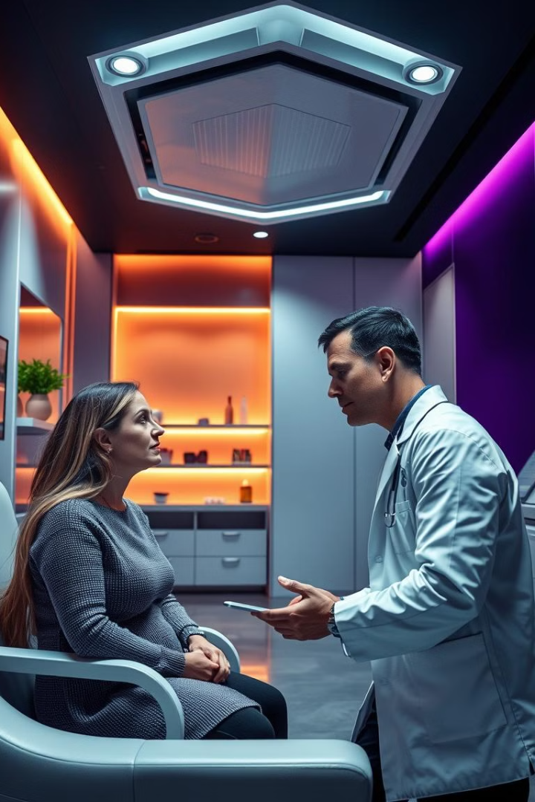
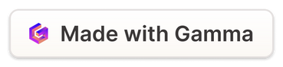
AI-BASED TOOL FOR PRELIMINARY DIAGNOSIS
OF DERMATOLOGICAL MANIFESTATIONS
21071A6609 B Tanuja
21071A6636 M Sriram
21071A6639 M Likitha
21071A6659 T Ganesh
GUIDE:
Dr N Sandhya
Notes:
1

Slide 2

ABSTRACT
The accurate diagnosis of dermatological manifestations is crucial for effective treatment and patient care. However, access to dermatologists can be limited, leading to delayed diagnoses and potential complications. This project aims to develop an AI-based tool to assist healthcare professionals in the preliminary diagnosis of dermatological conditions. By leveraging machine learning algorithms and image recognition techniques, the proposed system will analyze and classify skin lesions, rashes, and other skin abnormalities, providing potential diagnoses and recommendations for further evaluation. The tool will serve as an initial screening aid, enabling timely and informed decision-making while increasing accessibility to specialized dermatological expertise.
Notes:
1

Slide 3
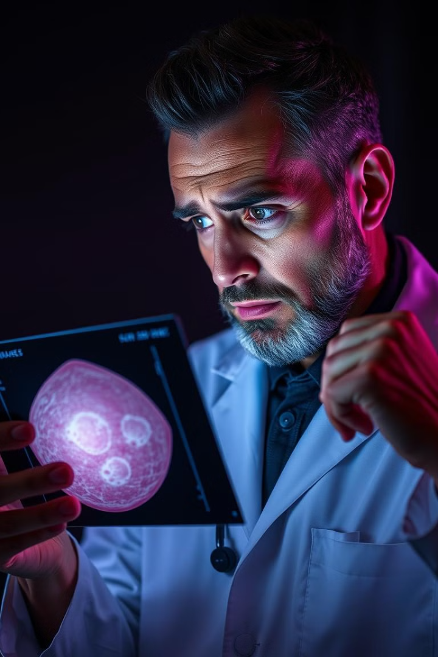
INTRODUCTION
•Dermatological manifestations encompass a wide range of skin conditions, from common rashes and infections to more serious diseases like melanoma.
• Early and accurate diagnosis is essential for successful treatment and prevention of complications. However, access to dermatologists can be limited, particularly in remote or underserved areas, leading to delays in diagnosis and treatment.
•By leveraging machine learning algorithms and advanced image recognition techniques, the tool will analyze and classify skin lesions, rashes, and other skin abnormalities, providing potential diagnoses and recommendations for further evaluation.
Notes:
4

Slide 4
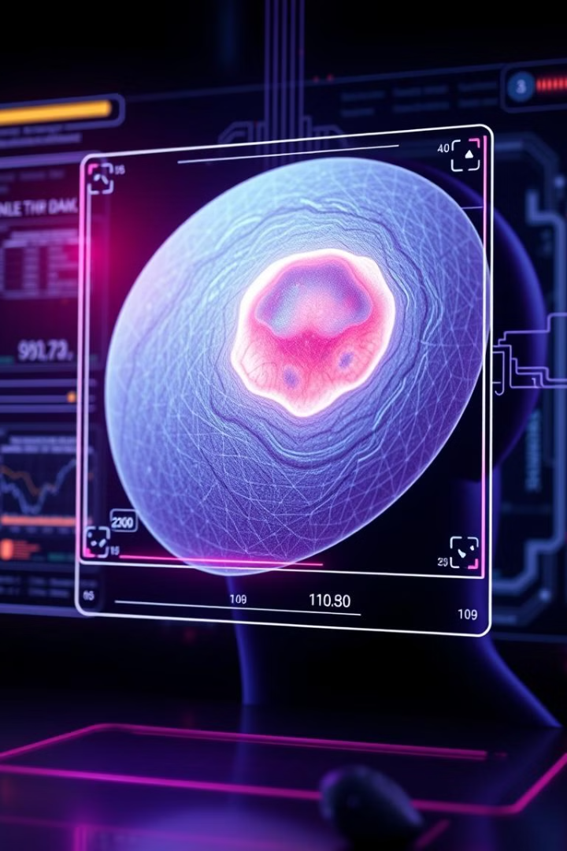
EXISTING SYSTEM
Currently, the diagnosis of dermatological manifestations primarily relies on visual examination by dermatologists or other healthcare professionals with specialized training. This process can be time-consuming and subject to human error or biases.
In some cases, tele dermatology services are available, where patients can submit images of their skin conditions for remote evaluation by dermatologists. However, these services are often limited in availability and accessibility, particularly in resource-constrained settings.
Notes:
5

Slide 5
RESEARCH GAP IDENTIFIED
While existing research has demonstrated the potential of AI-based tools in the diagnosis of skin conditions, there is a need for a comprehensive and user-friendly system that can be easily integrated into healthcare settings. Additionally, many existing solutions focus on specific conditions or skin lesions, limiting their applicability in a broader clinical context.
The proposed AI-based tool aims to address these gaps by providing a comprehensive solution for the preliminary diagnosis of a wide range of dermatological manifestations, while ensuring ease of use and integration into existing healthcare workflows.
Notes:
5

Slide 6
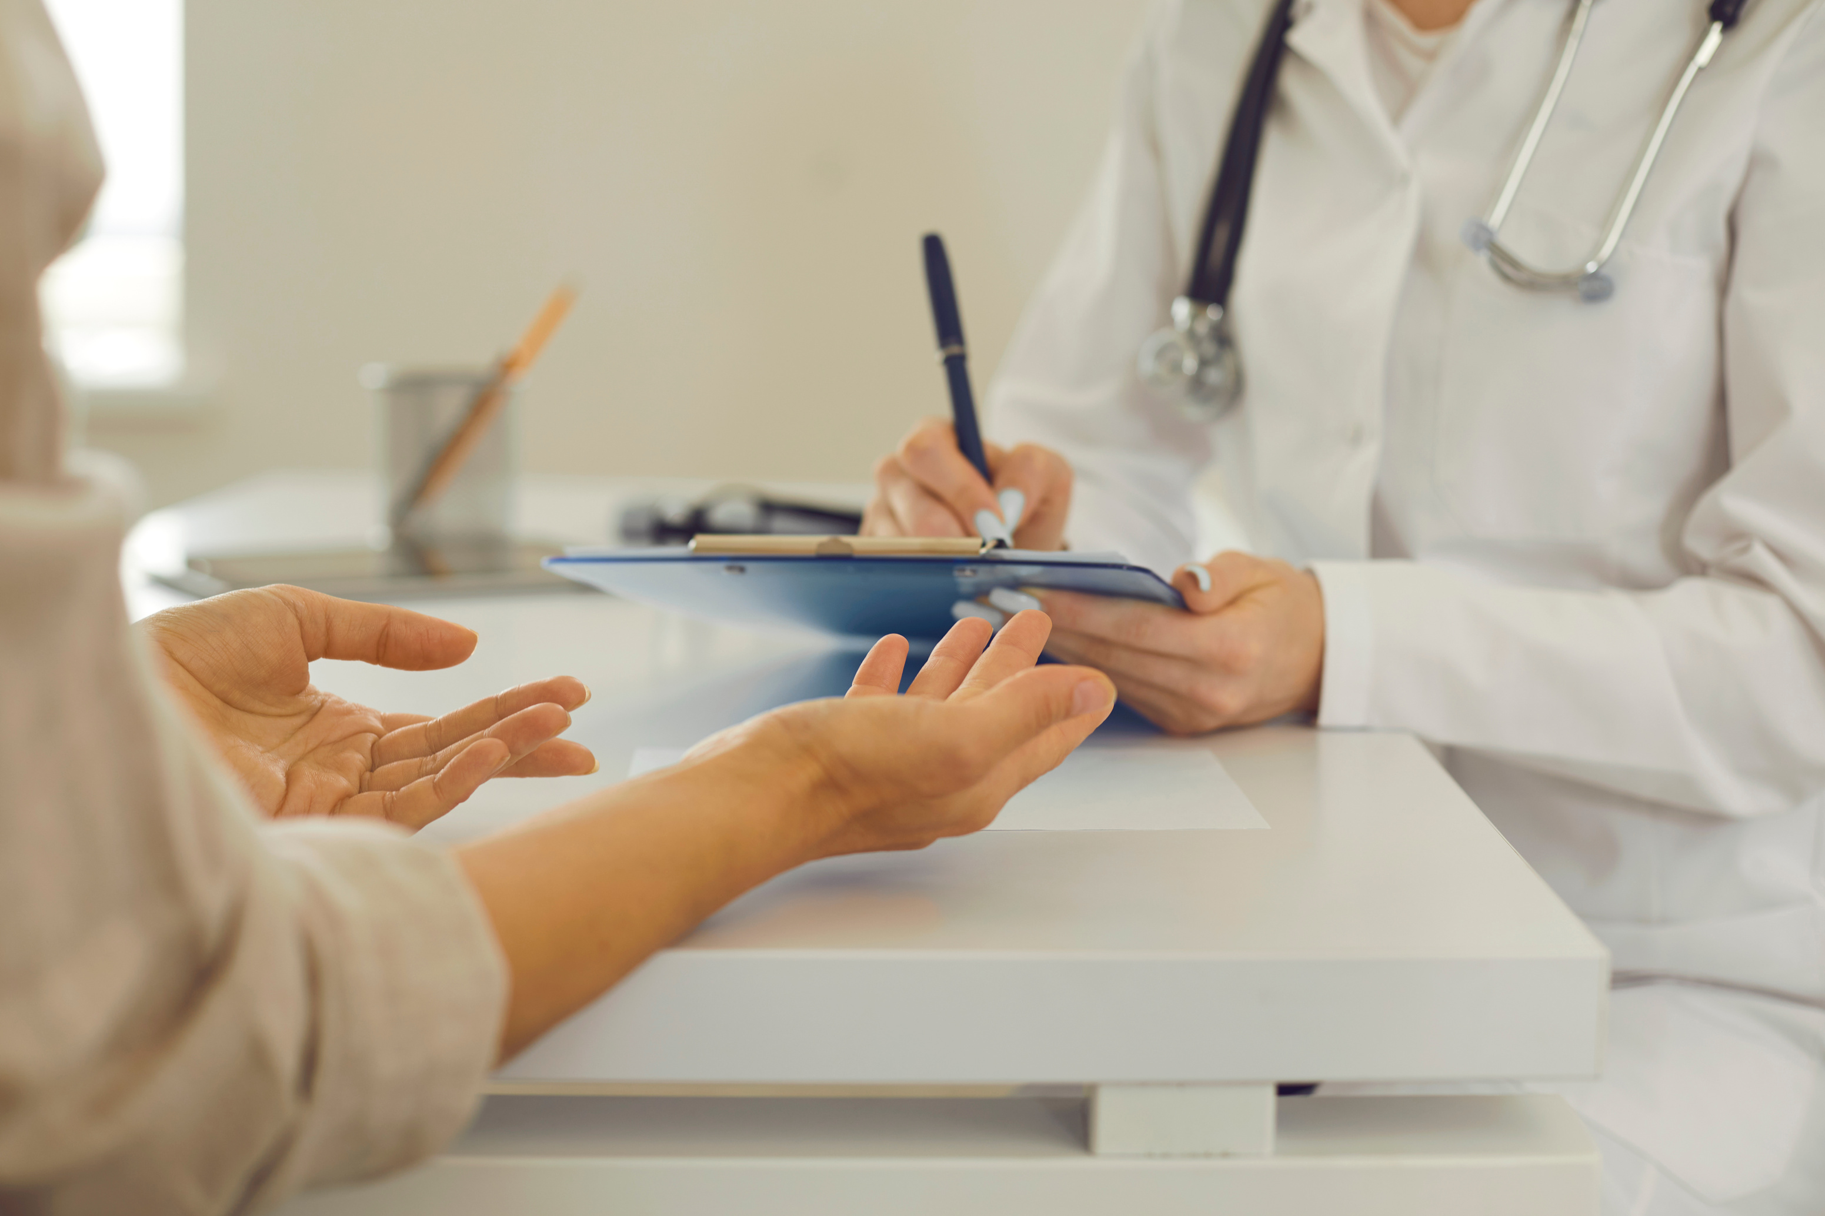

PROPOSED SYSTEM
Image Acquisition
Image Preprocessing
Machine Learning Model
Diagnostic Output
A user-friendly interface for healthcare professionals to upload or capture images of skin lesions, rashes, or other skin abnormalities.
Techniques for enhancing image quality, segmentation, and feature extraction to optimize the input for the machine learning model.
A deep learning model trained on a large dataset of annotated skin images, capable of classifying and identifying various dermatological manifestations.
The system will provide potential diagnoses, along with confidence scores and recommendations for further evaluation or referral to a dermatologist.
Notes:
5

Slide 7
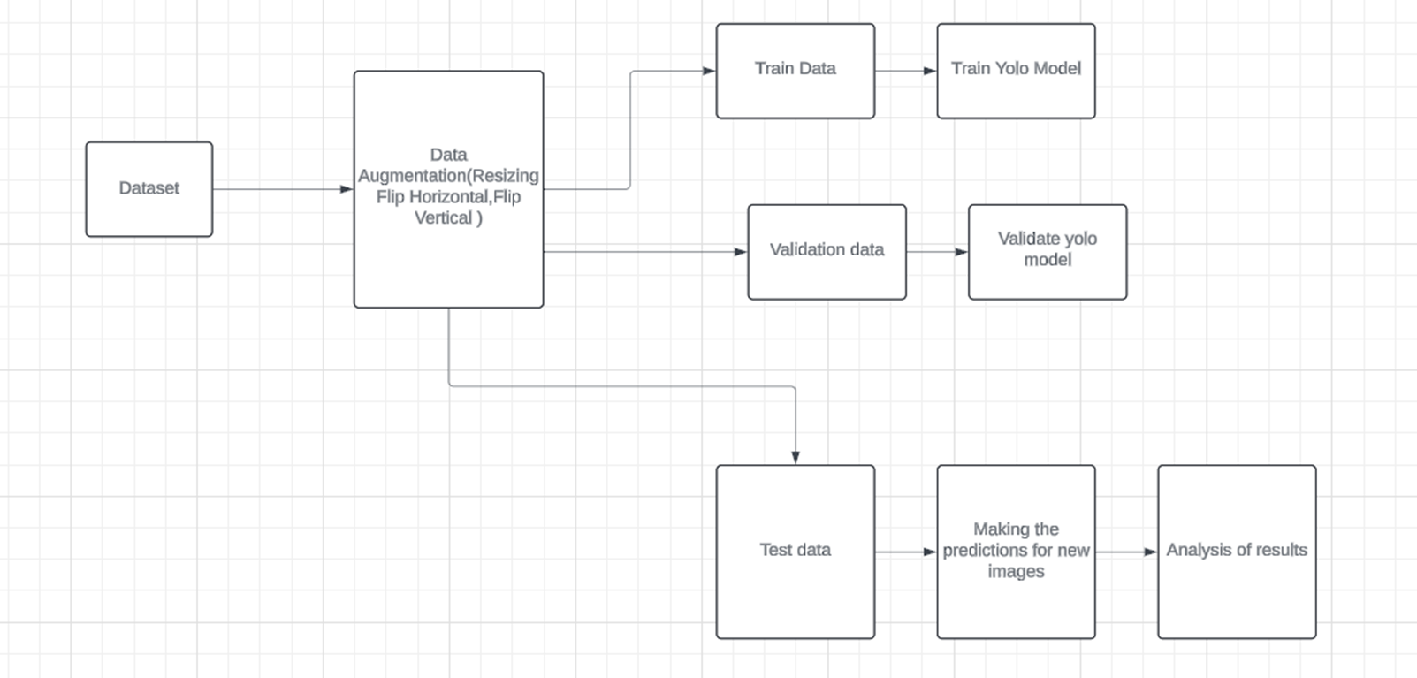
SYSTEM ARCHITECTURE
Notes:
2

Slide 8
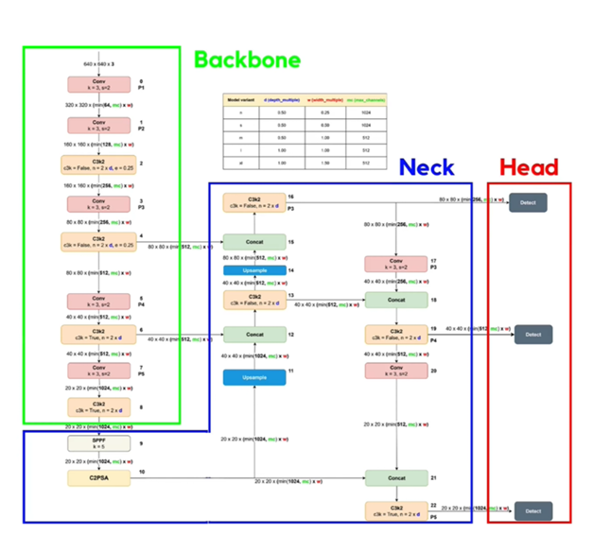
YOLOv11
ARCHITECTURE
Notes:
2

Slide 9
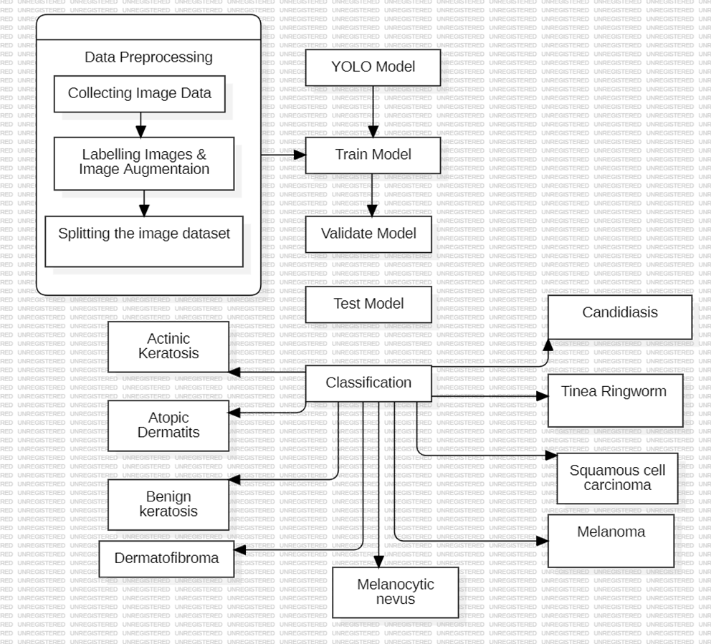
DATA FLOW
Notes:
2

Slide 10
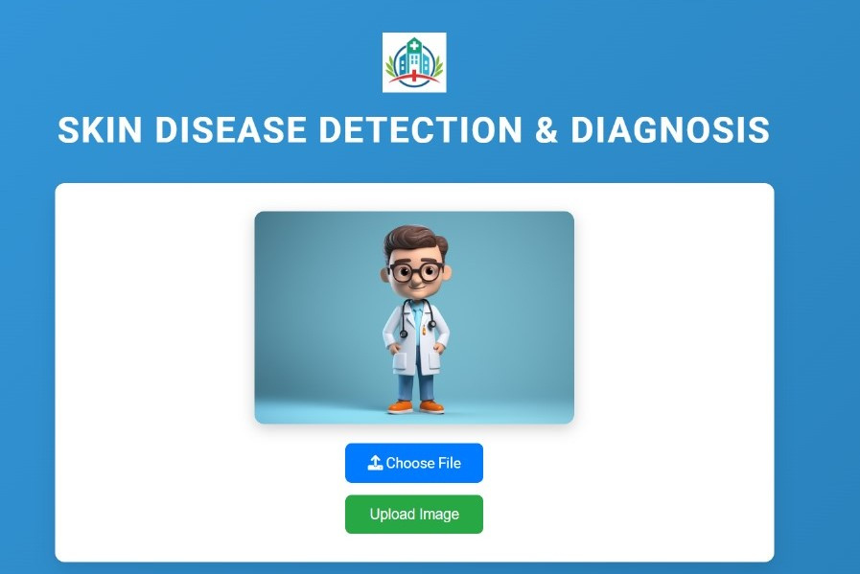
UI DESIGN
Notes:
2

Slide 11
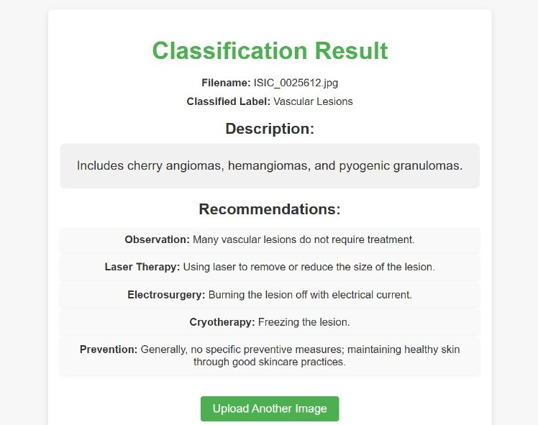
MODEL TESTING
Notes:
2

Slide 12
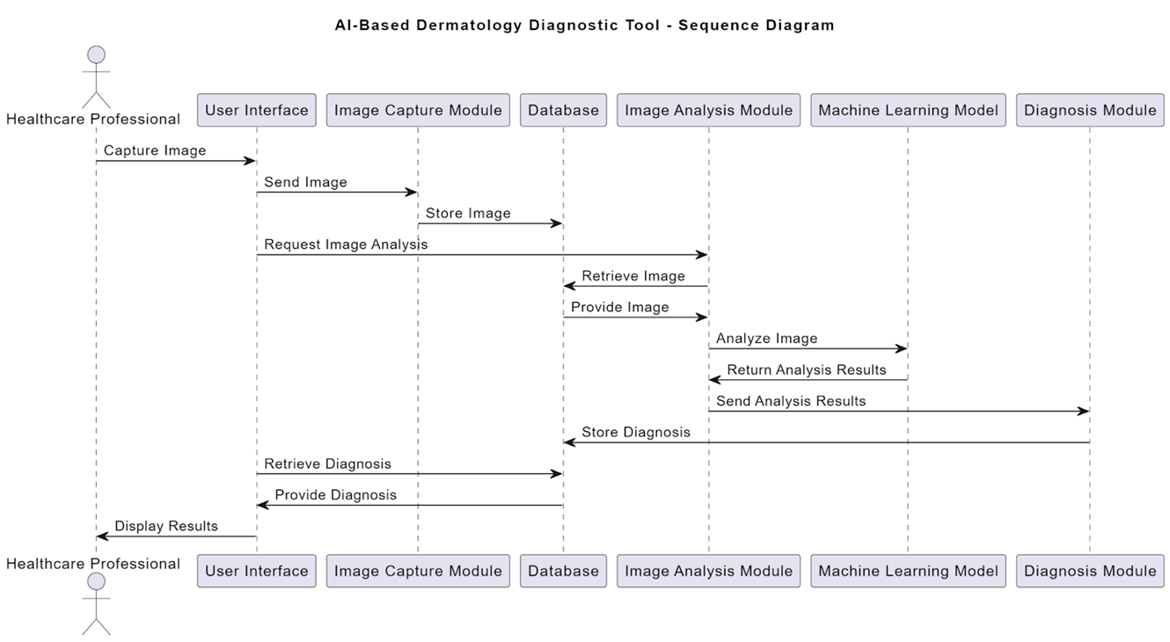
SEQUENCE DIAGRAM
Notes:
2

Slide 13
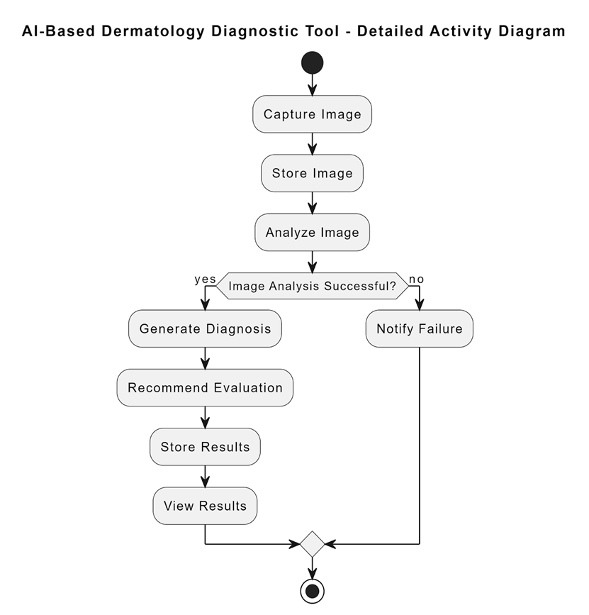
ACTIVITY DIAGRAM
Notes:
2

Slide 14
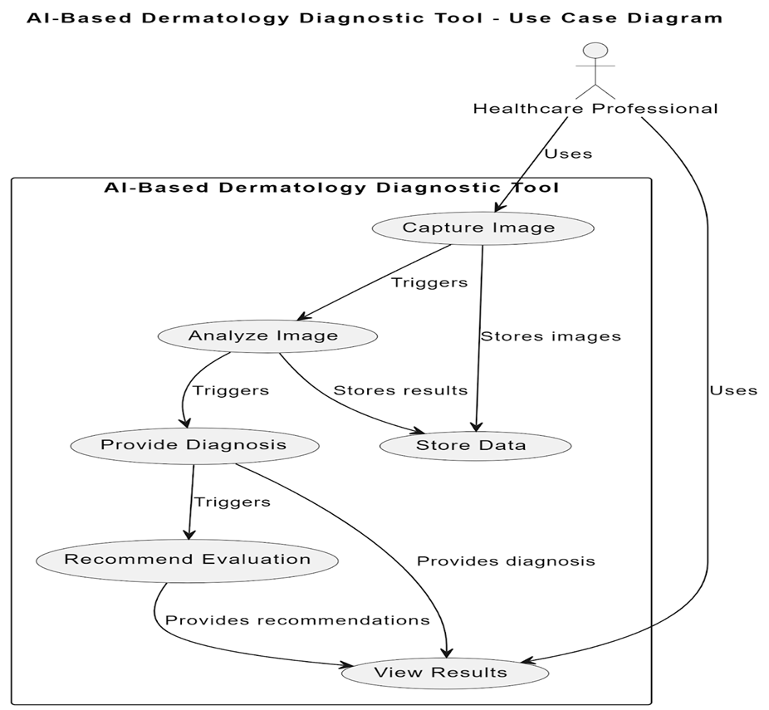
USECASE
DIAGRAM
Notes:
2

Slide 15
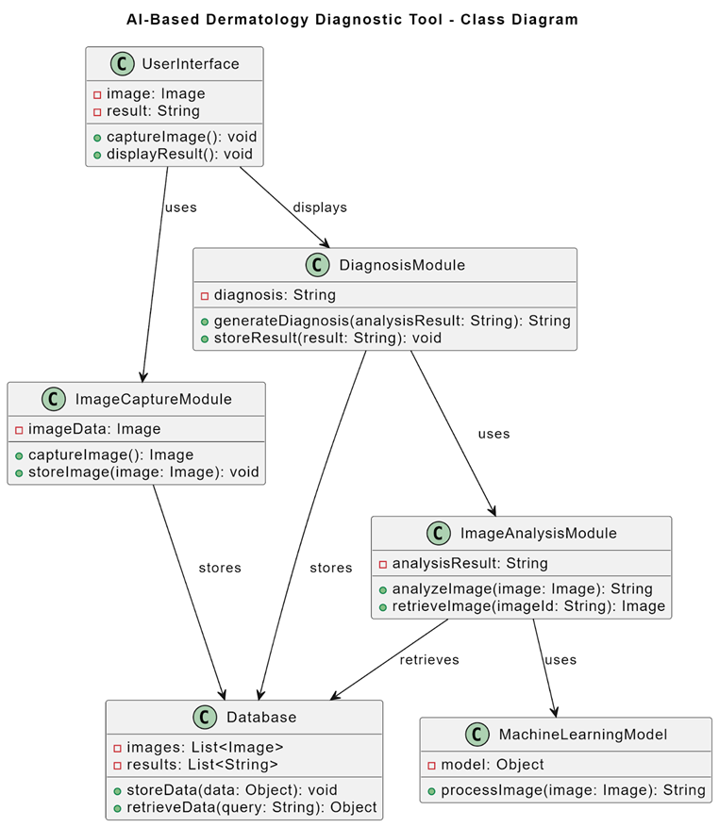
CLASS DIAGRAM
Notes:
2

Slide 16

REQUIREMENT VERIFICATION
FUNCTIONAL REQUIREMENTS
Data Requirements
UI Requirements
Model Requirements
Data format, Image Size, Data labelling, Data Volume
Image upload, Image display, Diagnosis results
Model architecture, Performance metrics, Training parameters
Notes:
3

Slide 17
Importance of Early Detection
Improved Outcomes
Reduced Complications
Increased Survival Rates
Early detection of skin diseases often leads to better treatment success.
Early intervention can prevent complications and reduce the risk of long-term health issues.
For certain skin cancers, early diagnosis significantly increases survival rates.
Notes:
3

Slide 18
Non Functional Requirements
Usability
Accuracy
It relates to the application's user-friendliness and establishes how simple it is for the user to utilize.
The degree to which the value generated by the system is near to the ideal value is determined by accuracy.
Responsiveness
Scalability
Responsiveness is determined by completing the software operations with minimal errors or no errors.
Scalability is used to determine the growth of the project. It establishes how much room the application can have for future feature expansion.
Notes:
4

Slide 19
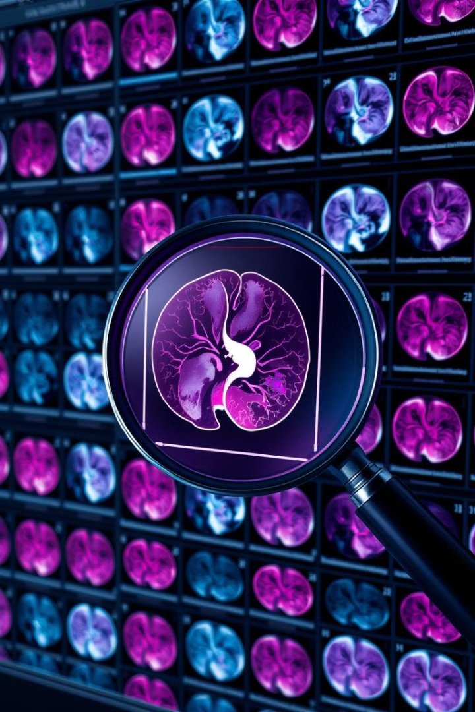
SYSTEM REQUIREMENTS
SOFTWARE REQUIREMENTS
OS,EDITOR
1
OS:Windows 11,Editor:Pycharm,Jupyter Notebook
PROGRAMMING LANGUAGES
2
PYTHON,LIBRARIES:Matplotlib, sklearn, numpy, pandas, Yolo, OpenCV
ALGORITHMS
3
Cosine Similarity
Notes:
6

Slide 20
HARDWARE REQUIREMENTS
1
PROCESSOR
Intel I7 Processor
2
STORAGE SPACE
500 GB
3
DEVICES REQUIRED
Mouse and a Keyboard
4
GPU
t4-gpu
5
MINIMUM RAM
8GB and a good Internet Connection
Notes:
6

Slide 21
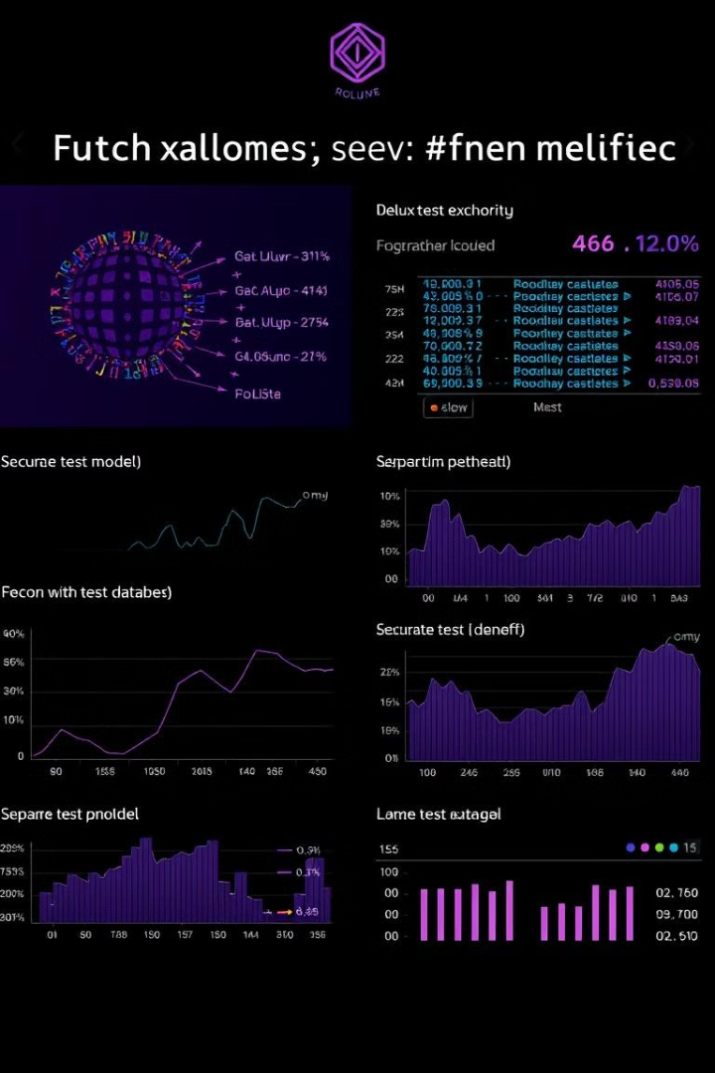
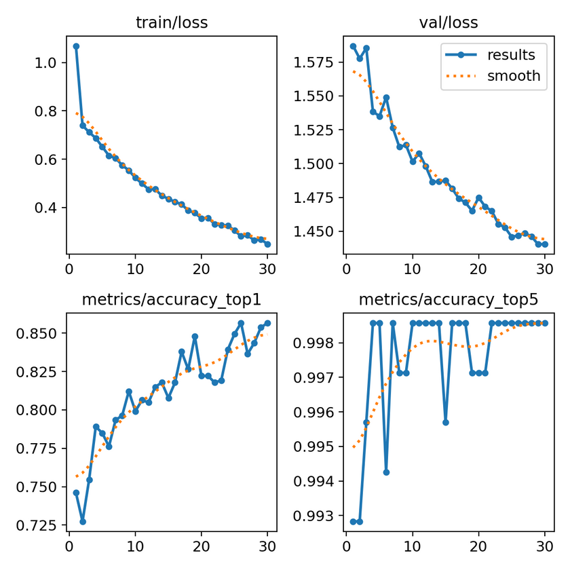
Evaluation
97.5%
Accuracy
Notes:
9

Slide 22
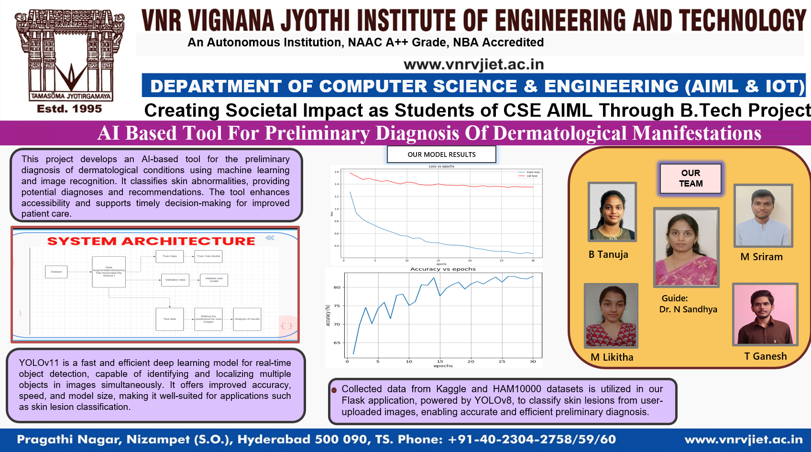
Notes:
10

